Slide 1
Elasticity (Part 1)

Slide 2
How To Approach the Study of Microeconomics
Microeconomics is the branch of economics that deals with human behaviour and choices as they relate to relatively small units: an individual, a firm, an industry, a single market.
It involves players (consumers, business firms, and factor owners) who have an objective, faces some constraints and has to make choices.
Let’s look at each of these players and what their objective, constraints and choices are.
All the choices are made in market settings, with different markets having different setups.

Slide 3
Players | Objective | Constraints | Choice
Consumers | Maximize utility of satisfaction by consuming goods and services | Finite Incomes Positive Prices | Chose between different bundles using marginal analysis
Firms as Buyers | Maximize profit | Positive Prices of Resources/Factors and cover opportunity costs | Chose mix of factors that will minimize cost using marginal analysis
Firms as Sellers | Maximize profit | -Consumers who wants to pay less for more -Competitors who will undercut prices | Chose quantity to produce, sell and decide on price
Factor Owners | Maximize income earned by selling factors | -Finite amount of factor -Market decides the price they will get | Chose to sell units of factor based on marginal analysis

Slide 4
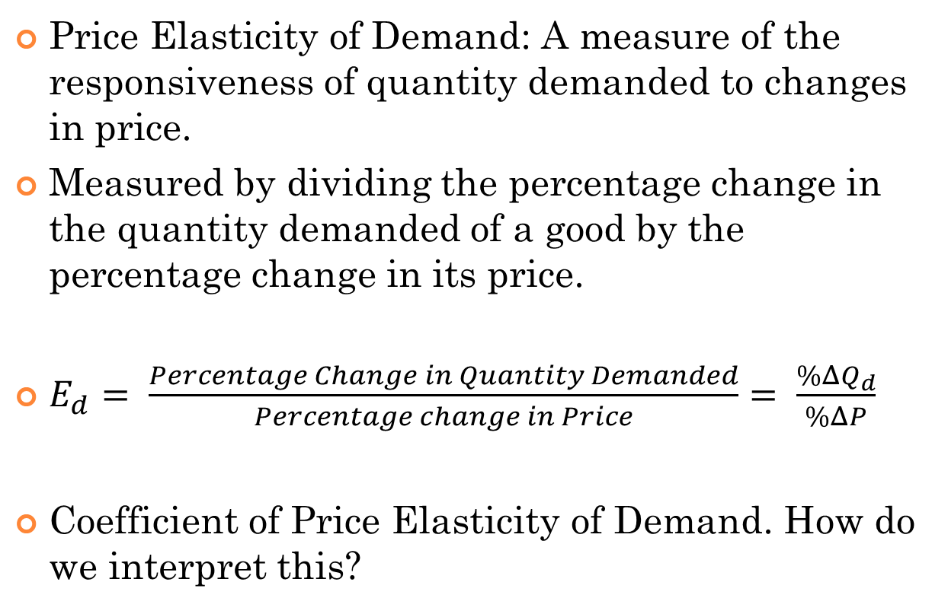
Elasticity (Part 1)
Price Elasticity of Demand: A measure of the responsiveness of quantity demanded to changes in price.
Measured by dividing the percentage change in the quantity demanded of a good by the percentage change in its price.
$E_{d}= \frac{Percentage Change in Quantity Demanded}{Percentage change in Price}= \frac{\%ΔQ_{d}}{\%ΔP}$
Coefficient of Price Elasticity of Demand. How do we interpret this?

Slide 5
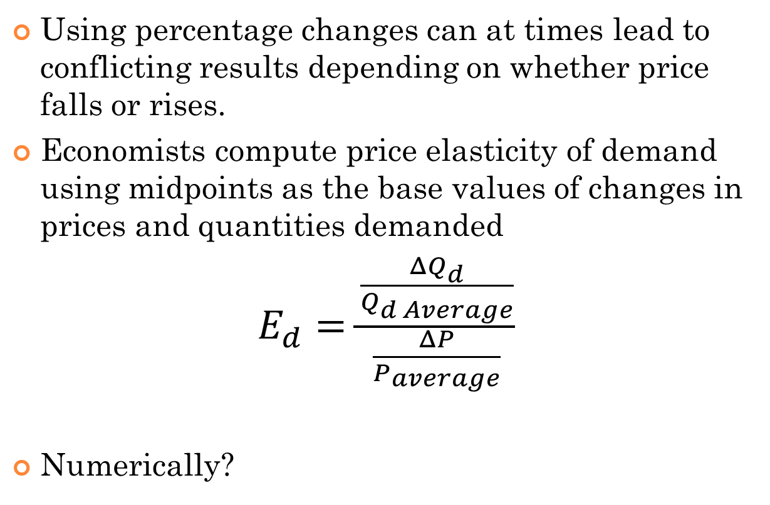
Price Elasticity of Demand
Using percentage changes can at times lead to conflicting results depending on whether price falls or rises.
Economists compute price elasticity of demand using midpoints as the base values of changes in prices and quantities demanded
$E_{d}=\frac{\frac{ΔQ_{d}}{Q_{d Average}}}{\frac{ΔP}{P_{average}}}$
Numerically?

Slide 6
Elasticity is NOT Slope
Point | Price | Quantity Demanded
A | 12 | 50
B | 10 | 100
C | 8 | 150
What is the Price Elasticity of Demand from Point A to B?
What is the slope from A to B?
What is the Price Elasticity of Demand from Point B to C?
What is the slope from B to C?
Are they the same?

Slide 7
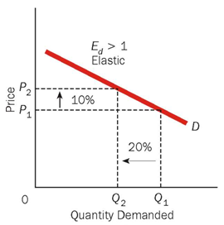
Elastic Demand
The demand when the percentage change in quantity demanded is greater than the percentage change in price. Quantity demanded changes proportionately more than the price.
%∆Qd > %∆P ➔ Ed > 1 ➔ Demand is elastic

Slide 8
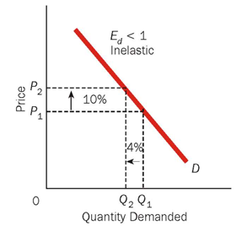
Inelastic Demand
The demand when the percentage change in quantity demanded is less than the percentage change in price. Quantity demanded changes proportionately less than the price.
%∆Qd < %∆P ➔ Ed < 1 ➔ Demand is inelastic

Slide 9
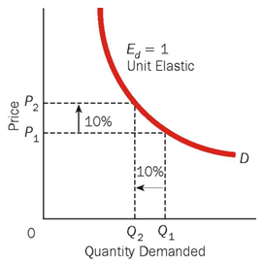
Unit Elastic Demand
The demand when the percentage change in quantity demanded is equal to the percentage change in price. Quantity demanded changes proportionately to the price.
%∆Qd = %∆P ➔ Ed = 1 ➔ Demand is unit elastic

Slide 10
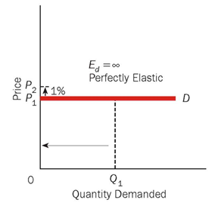
Perfectly Elastic Demand Curve
The demand when a small percentage change in price causes an extremely large percentage change in quantity demanded (from buying all to buying nothing.)
Ed = ∞ (Infinitely large)

Slide 11
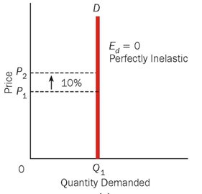
Perfectly Inelastic Demand Curve
The demand when the quantity demanded does not change as price changes. So the demand is completely UNRESPONSIVE to changes in demand.
Ed = 0

Slide 12
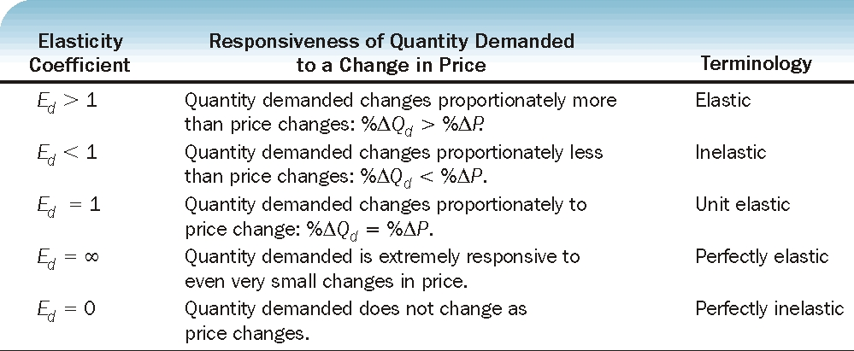
Summarizing…

Slide 13
Price Elasticity and Total Revenue (Total Expenditure)
Total Revenue of a seller equals the price of a good tines the quantity of the good sold.
TR = P * Q
Question: Does rise in price mean higher revenue?
When prices increases ➔ Quantity demanded will fall because Demand is downward sloping.
How does changes in prices impact total revenue?
Whether TR increases or decreases or remains same, depends on whether percentage change in quantity demand is less than, greater than or equal to percentage change in price ➔ Price Elasticity of Demand.

Slide 14
Elastic Demand and Total Revenue
Quantity demanded changes proportionately more than the price.
%∆Qd > %∆P ➔ Ed > 1 ➔ Demand is elastic
If price falls, Qd rises by a bigger percentage ➔ Sales of the good rises by a bigger percentage ➔ TR revenue rises.
If price rises, Qd falls by a bigger percentage ➔ Sales of the good falls by a bigger percentage ➔ TR revenue falls.

Slide 15
Inelastic Demand and Total Revenue
Quantity demanded changes proportionately less than the price.
%∆Qd < %∆P ➔ Ed < 1 ➔ Demand is inelastic
If price falls, Qd rises by a smaller percentage ➔ Sales of the good rises by a smaller percentage ➔ TR revenue falls.
If price rises, Qd falls by a smaller percentage ➔ Sales of the good falls by a smaller percentage ➔ TR revenue rises.

Slide 16
Unit elastic Demand and Total Revenue
Quantity demanded changes proportionately equal to the price.
%∆Qd = %∆P ➔ Ed = 1 ➔ Demand is unit elastic
If price falls, Qd rises by a same percentage ➔ Sales of the good rises by a same percentage ➔ TR revenue stays same.
If price rises, Qd falls by the same percentage ➔ Sales of the good falls by same percentage ➔ TR revenue stays same.

Slide 17
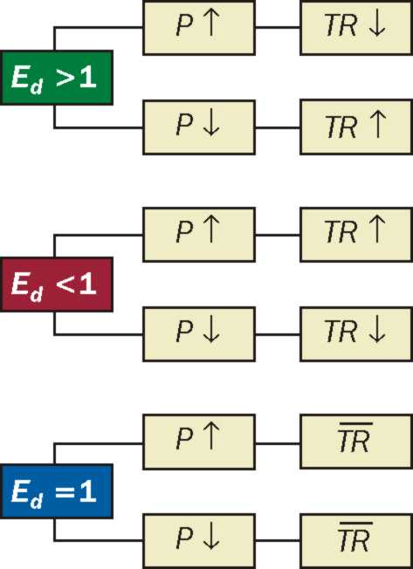
Summarizing…

